Slide 1


Slide 2


Building rich Skottie animations for cross-platform .NET applications
Jerome Laban
CTO, Uno Platform

Slide 3
Agenda
Skottie, Lottie and SkiaSharp
Uno Platform Quick Overview
Skottie PR
Demo

Slide 4
SkiaSharp + Lottie = Skottie

Slide 5
Lottie, SkiaSharp, Skottie

Slide 6
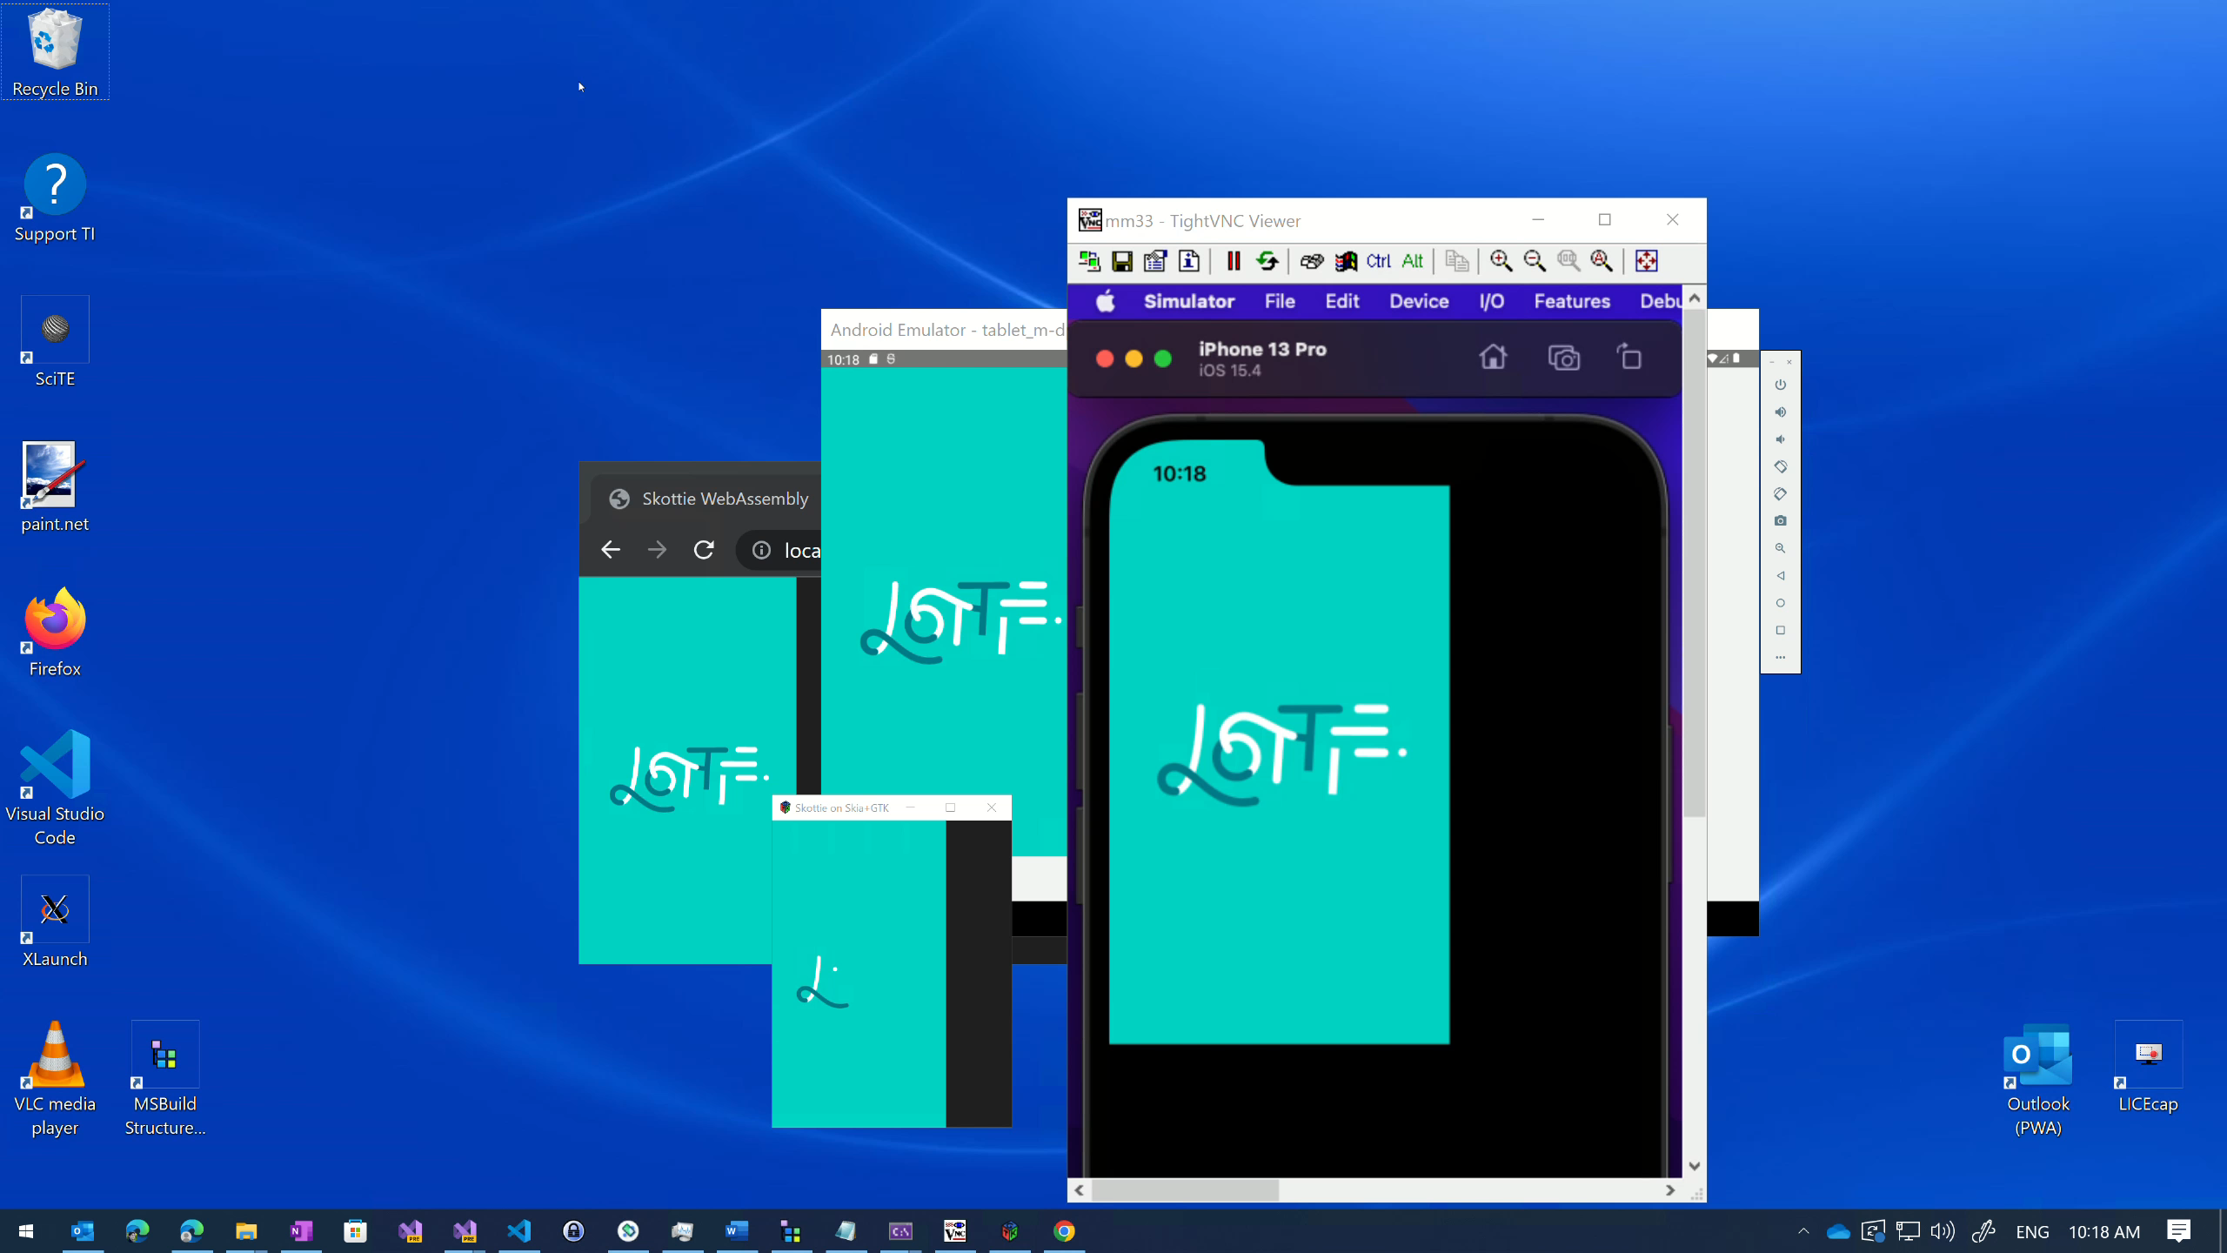

Slide 7
Uno Platform Quick Overview

Slide 8
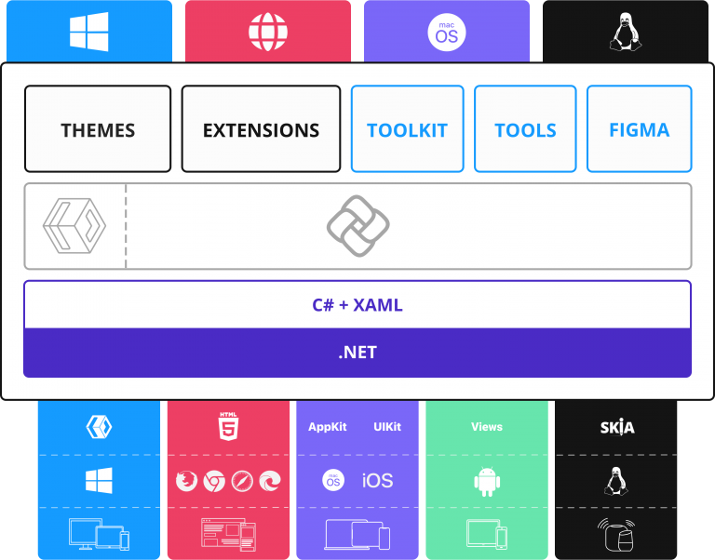
Uno Platform Quick Overview
WinUI XAML & C#
Everywhere .NET runs
Single Codebase
Pixel Perfect
Free and Open Source (Apache 2.0)

Slide 9
Uno Platform: Animated Visual Player
Available on all platforms Uno Platform runs on
More WinUI controls are using it
More advanced scenarios coming

Slide 10
SkiaSharp / Skottie PR

Slide 11
Demo

Slide 12

Thanks for joining!
Ask your questions live on Twitter #dotNETConf
More info: platform.uno/Skottie

